Slide 1
Collections in Java
Lecture - 26

Slide 2
What is Collection in Java????
A single unit of objects i.e a group

Slide 3
Collections in Java
It provides readymade architecture
What is framework in Java????
It represents a set of classes and interfaces
It is optional

Slide 4
Collection framework in Java
It represents a unified architecture for storing and manipulating a group of objects.
It has:
Interfaces and its implementations, i.e., classes
Algorithm

Slide 5
Two Main Collection framework in Java
Collection interface
java.util.Collection
Map interface
java.util.Map

Slide 6
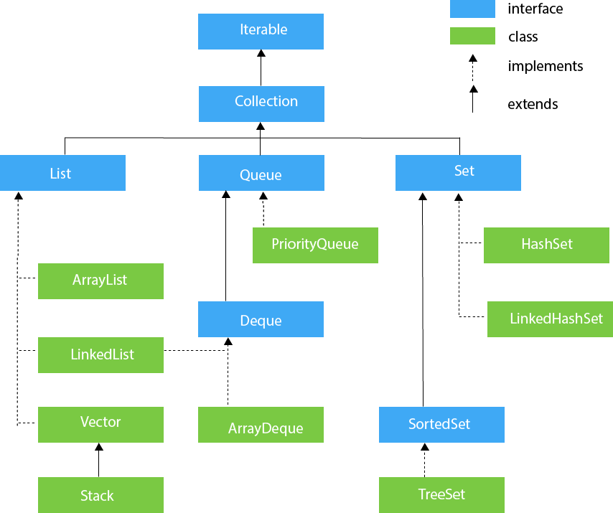
Collection framework in Java
java.util - package contains all this classes and interfaces

Slide 7
Collections in Java
Iterator interface:
Iterator interface provides the facility of iterating the elements in a forward direction only

Slide 8
Methods of iterator interface
public boolean hasNext()
Iterator interface has 3 methods
public Object next()
public void remove()

Slide 9
It returns true if the iterator has more i.e next elements
otherwise it returns false
public boolean hasNext()

Slide 10
It returns the element and moves the cursor pointer to the next element
public Object next()

Slide 11
It removes the last elements returned by the iterator.
It is less used.
public void remove()

Slide 12
List in Java
List interface is the child interface of Collection interface.
It inhibits a list type data structure in which we can store the ordered collection of objects.
It can have duplicate values.

Slide 13
List in Java
List interface is implemented by the classes
ArrayList,
LinkedList,
Vector, and
Stack.

Slide 14
List in Java
How to instantiate the List interface for arrays???
List <data-type> obj= new ArrayList();

Slide 15
List in Java
How to instantiate the List interface for
linked-list???
List <data-type> obj= new LinkedList();

Slide 16
List in Java
How to instantiate the List interface for
Vector???
List <data-type> obj= new Vector();

Slide 17
List in Java
How to instantiate the List interface for
Stack???
List <data-type> obj= new Stack();

Slide 18
List in Java
List <data-type> list1= new ArrayList();
How to instantiate the List interface ???
List <data-type> list2 = new LinkedList();
list1,list2,list3,list4 are objects
List <data-type> list3 = new Vector();
List <data-type> list4 = new Stack();

Slide 19
ArrayList in Java
It uses a dynamic array to store the duplicate element of different data types.
The ArrayList class maintains the insertion order and is non-synchronized.
The elements stored in the ArrayList class can be randomly accessed

Slide 20

ArrayList in Java
public class Test
{
public static void main(String args[])
{
ArrayList<String> list=new ArrayList<String>();
list.add("Ravi");
list.add("Vijay");
list.add("Ravi");
list.add("Ajay");
Iterator itr=list.iterator();
while(itr.hasNext())
{
System.out.println(itr.next());
}
}
}
ArrayList of Strings is instantiated in the name of object list
Using the method add(), inserting inputs to the object list
Using the interface Iterator, we can move the elements in forward direciton
Using the method hasNext(), we can iterate to next elements in the list
Output:

Slide 21
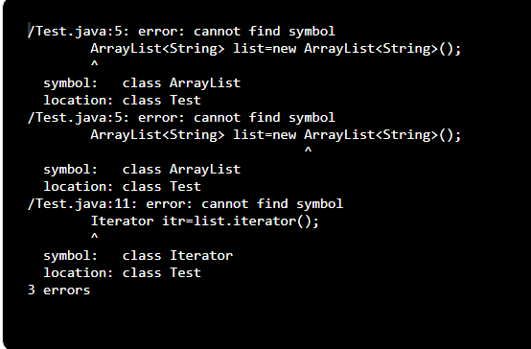
ArrayList in Java
ERROR

Slide 22
ArrayList in Java
import java.util.*;
public class Test
{
public static void main(String args[])
{
ArrayList<String> list=new ArrayList<String>();
list.add("Ravi");
list.add("Vijay");
list.add("Ravi");
list.add("Ajay");
Iterator itr=list.iterator();
while(itr.hasNext())
{
System.out.println(itr.next());
}
}
}
Therefore we can say ArrayList will accept duplicate values also
Here Ravi is repeated twice
Output:
Ravi
Vijay
Ravi
Ajay

Slide 23
LinkedList in Java
It uses a doubly linked list internally to store the elements.
It can store the duplicate elements.
It maintains the insertion order and is not synchronized.
In LinkedList, the manipulation is fast because no shifting is required

Slide 24
LinkedList in Java
import java.util.*;
public class Test
{
public static void main(String args[])
{
LinkedList<String> obj=new LinkedList<String>();
obj.add("Face");
obj.add("Focus");
obj.add("Academy");
obj.add("Face");
Iterator itr=obj.iterator();
while(itr.hasNext())
{
System.out.println(itr.next());
}
}
}
Whatever datatype we want ,we can give inside <>
Output:
Face
Focus
Academy
Face

Slide 25
Vector in Java
Vector uses a dynamic array to store the data elements.
It is similar to ArrayList but it is synchronized

Slide 26
Vector in Java
import java.util.*;
public class Test
{
public static void main(String args[])
{
Vector<String> obj=new Vector<String>();
obj.add("Face");
obj.add("Focus");
obj.add("Academy");
obj.add("Face");
Iterator itr=obj.iterator();
while(itr.hasNext())
{
System.out.println(itr.next());
}
}
}
Whatever datatype we want ,we can give inside <>
Output:
Face
Focus
Academy
Face

Slide 27
Stack in Java
The stack is the subclass of Vector.
It implements the last-in-first-out data structure, i.e., Stack.
The stack contains all of the methods of Vector class and also provides its methods like
boolean push(),
boolean peek(),
boolean push(object o)

Slide 28
Stack in Java
import java.util.*;
public class Test
{
public static void main(String args[])
{
Stack<String> obj=new Stack<String>();
obj.add("Face");
obj.add("Focus");
obj.add("Academy");
obj.add("Face");
Iterator itr=obj.iterator();
while(itr.hasNext())
{
System.out.println(itr.next());
}
}
}
Whatever datatype we want ,we can give inside <>
Output:
Face
Focus
Academy
Face

Slide 29
Set in Java
Set Interface in Java is present in java.util package.
It extends the Collection interface.
It represents the unordered set of elements which doesn't allow us to store the duplicate items.
We can store at most one null value in Set.

Slide 30
Set in Java
Set is implemented by
HashSet (access randomly)
LinkedHashSet (HashSet in LinkedList concept)
TreeSet (access in an order either alphabetical or ascending)

Slide 31
Set in Java
How to instantiate the Set interface for HashSet???
Set<data-type> s1 = new HashSet<data-type>();

Slide 32
Set in Java
How to instantiate the Set interface for LinkedHashSet ??
Set<data-type> s2 = new LinkedHashSet<data-type>();

Slide 33
Set in Java
How to instantiate the Set interface for
TreeSet???
Set<data-type> s3 = new TreeSet<data-type>();

Slide 34
Set in Java
Set<data-type> s1 = new HashSet<data-type>();
How to instantiate the Set interface ???
Set<data-type> s2 = new LinkedHashSet<data-type>();
Set<data-type> s3 = new TreeSet<data-type>();

Slide 35
HashSet in Java
HashSet class implements Set Interface.
It represents the collection that uses a hash table for storage.
Hashing is used to store the elements in the HashSet.
It contains unique items

Slide 36
HashSet in Java
import java.util.*;
public class Test
{
public static void main(String args[])
{
HashSet<String> obj=new HashSet<String>();
obj.add("Face");
obj.add("Focus");
obj.add("Academy");
obj.add("Face");
Iterator itr=obj.iterator();
while(itr.hasNext())
{
System.out.println(itr.next());
}
}
}
It stores the data in an unordered way in memory
So, it removes duplications when it is retrieved
Output:
Focus
Academy
Face

Slide 37
LinkedHashSet in Java
LinkedHashSet class represents the LinkedList implementation of Set Interface.
It extends the HashSet class and implements Set interface.
Like HashSet, It also contains unique elements.
It maintains the insertion order and permits null elements.

Slide 38
LinkedHashSet in Java
import java.util.*;
public class Test
{
public static void main(String args[])
{
LinkedHashSet<String> obj=new LinkedHashSet<String>();
obj.add("Face");
obj.add("Focus");
obj.add("Academy");
obj.add("Face");
Iterator itr=obj.iterator();
while(itr.hasNext())
{
System.out.println(itr.next());
}
}
}
It stores the data in an unordered way in memory using doubly linked list concept
So, it removes duplications when it is retrieved
Output:
Focus
Academy
Face

Slide 39
TreeSet in Java
Java TreeSet class implements the Set interface
It uses a tree for storage.
Like HashSet, TreeSet also contains unique elements.
The access and retrieval time of TreeSet is quite fast.
The elements in TreeSet stored in ascending order.

Slide 40
TreeSet in Java
import java.util.*;
public class Test
{
public static void main(String args[])
{
TreeSet<String> obj=new TreeSet<String>();
obj.add("Face");
obj.add("Focus");
obj.add("Academy");
obj.add("Face");
Iterator itr=obj.iterator();
while(itr.hasNext())
{
System.out.println(itr.next());
}
}
}
It stores the data in an unordered way in memory using Tree concept
So, it removes duplications when it is retrieved
Output:
Focus
Academy
Face

Slide 41
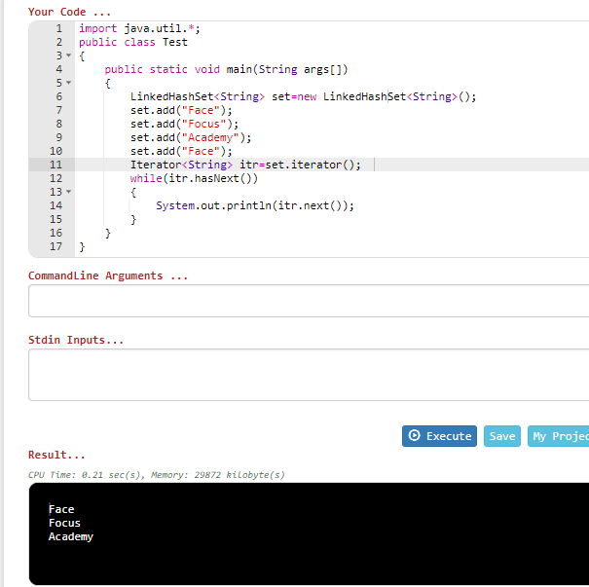
LinkedHashSet
CPU time: 0.21 sec

Slide 42
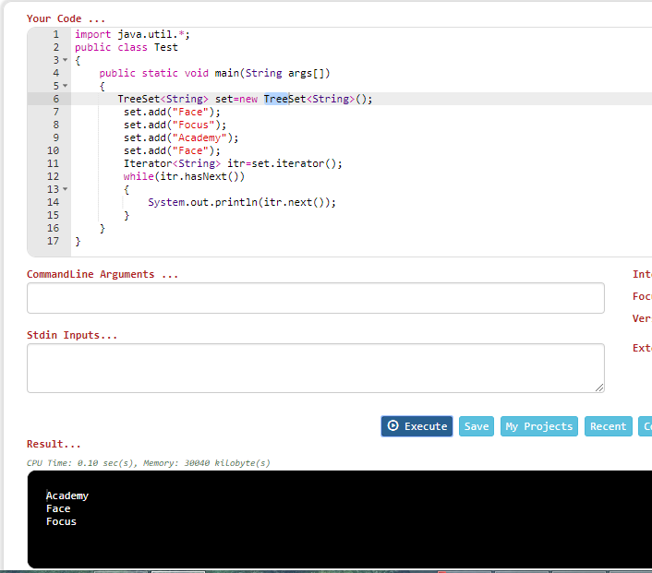
TreeSet
CPU time: 0.10 sec

Slide 43
Map Interface
A map contains values on the basis of key, i.e. key and value pair.
Each key and value pair is known as an entry.
A Map contains unique keys.
A Map is useful if you have to search, update or delete elements on the basis of a key.

Slide 44
Map Interface
Entry
Entry
Entry
1
Face
1
Training
5
Focus
2
Key value should not be same
Key
Value
Key
Value
Key
Value

Slide 45
Map Interface
import java.util.*;
public class HashMapDemo
{
public static void main(String args[])
{
Map< String,Integer> hm = new HashMap< String,Integer>();
hm.put("a", new Integer(100));
hm.put("b", new Integer(200));
hm.put("c", new Integer(300));
hm.put("d", new Integer(400));
Set< Map.Entry< String,Integer> > st = hm.entrySet();
for (Map.Entry< String,Integer> me:st)
{
System.out.print(me.getKey()+":");
System.out.println(me.getValue());
}
}
}
Output:
a:100
b:200
c:300
d:400

Slide 46


